Slide 1
The Problem: Sloppy Handwriting of Doctor
A doctors’ handwriting can only be understood either by the doctors themselves or by a pharmacist. Often times the doctors write the prescription in a hurry, or say, too sloppy that it becomes hard to discern the prescription (even by the pharmacists) which leads to inconsistency, and an unwanted prescribed drug might be given to the patient merely because of the wrong understanding of the medication’s name. This haphazard decision may lead to the death of that patient. To eliminate the risk of misunderstanding of the doctor’s handwriting, we have come up with an idea.

Slide 2
Idea Description: Voicy
The idea is to design an app to write formatted prescriptions based on dictation from a doctor. The app will be able to send the prescription to the patient directly on his/her phone and email-ID. A doctor should be able to dictate his/her prescription to the patient while talking to his/her phone or PC running windows ( version 7 and above).
The Chemist should be able to either preview or hear the prescription as prescribed or signed by the doctor with a digital signature on the prescription.

Slide 3
Existing Methodology:
Currently, prescription is not being made in digital format.
Most of the doctors in India use prescription pads to prescribe medicines to their patients.
Disadvantages of existing methodologies:-
Many doctors have an illegible handwriting and it is a global problem. From the perspective of patients, illegible handwriting in prescription writing could result in serious repercussions, including death of the patients.

Slide 4
Technology Stack we will use for the project
We will use an open source, the elegant programming language- Python
Speech recognition is an important aspect of our project and to maintain its quality we have used Google speech-recognition API to understand more than 120 languages and different accents.
Jupyter and Spyder for their vast number of libraries availability, for free!
Android studio to design an adaptive and easy to use application’s user interface.

Slide 5
Use Cases
The most basic use case can be followed as;
Login and authentication of patients and doctors.
Doctor then can add the patients to their list.
Doctor will prescribe the prescription using the app (Voicy).
Before sending the prescription to the patient the doctor can view or edit it.
As soon as the doctor will send it, the patient will receive an email or a Whatsapp with the attached prescription in it.
The patient history(EHR) will be saved in the doctor’s archive for future purposes.

Slide 6
Dependencies:
Our project will use Python 2.7 or newer Python 3.7.
Google speech recognition V1.
Spyder 3.3.6 stable release in July 2019.
Jupyter 6.6.0 .
Android studio 3.5, August 2019.
Show stopper:
*There are no show stoppers in our project!*

Slide 7
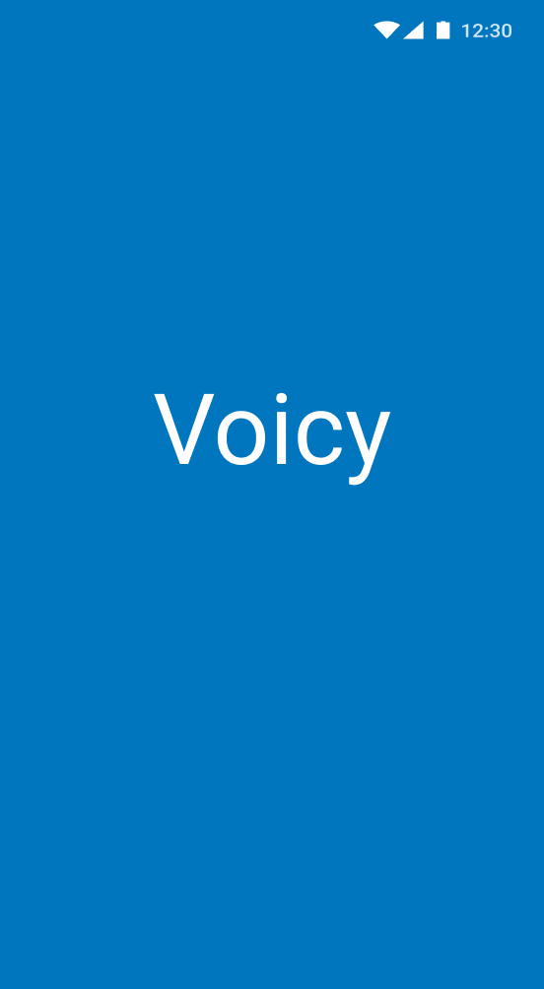
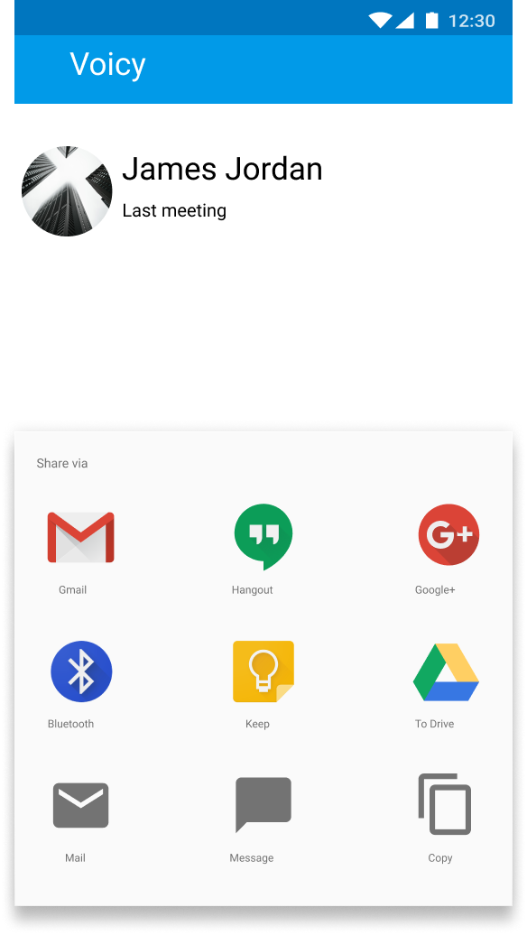
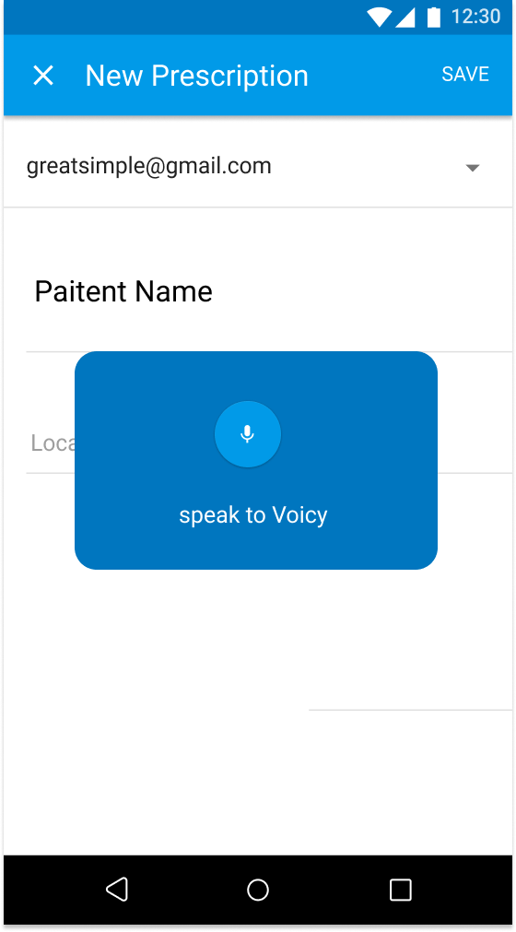
A Glimpse Of Our Prototype:

